Slide 1

Character Emotional Analysis Service with Python NLTK
20190253 Seungjun Park, 20220049 Chaewoon Ki
Notes:
Hello, we are going to present our team project presentation. We designed ~~

Slide 2
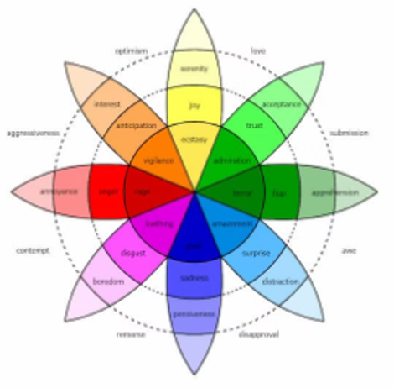
Introduction- program description
Emotion Analyzer is a program designed to identify character names in a novel text and track the emotional changes of each character over time.
When reading a novel, detecting emotions of the characters and tracking the changes are crucial to understand a storyline of the novel.
The program uses Plutchik's (1980) "Wheel of Emotions" to classify emotions.
The extracted emotional information is saved in a TSV file for each character.
Notes:
In this project, we designed a program to "analyze the emotions felt by characters" when the novel is given. (본문 두번째 읽기). Our Emotion Analyzer identifies and classifies how characters' emotions change in the text.
When a sentence from the novel is given, our program detects the characters' names and classifies their sentiments into one of eight emotion categories. The results are then saved in a TSV file.

Slide 3

Approach
Character analyzer
Emotion Detector
Match sentiments
with character class
Extract the name of the character from the sentence
Create Character Objects
Detect the emotions in the sentence
Notes:
I will now explain how the Emotion Analyzer works. \
Each sentence in a novel undergoes three stages: Character Analyzing, Emotion Detecting, and Sentiment Matching.
The Character Analyzer identifies the names of characters in the sentence and creates a character object with the corresponding name. The Emotion Detector detects sentimentss in each sentence and returns the emotions present in that sentence. Finally, the characters in the sentence and their emotions are stored together in a Character object.

Slide 4
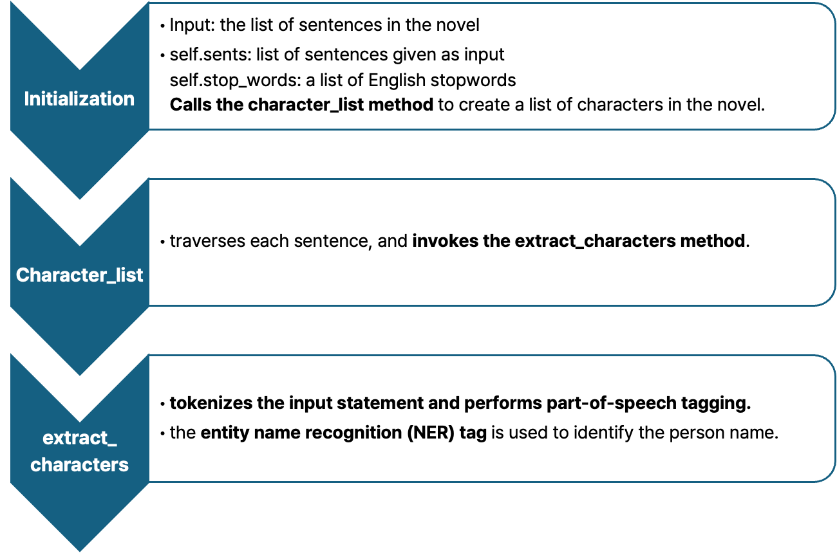
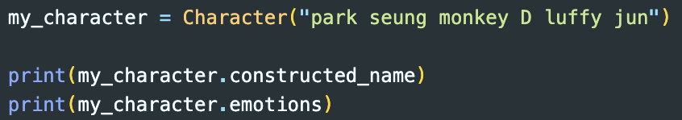

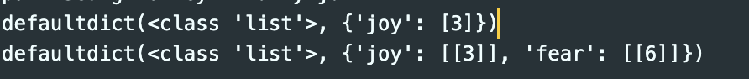
Approach - Character analyzer
Notes:
Now, let's see in detail how the Character Analyzer and Emotion Detector works.
The Character Analyzer extracts characters from the given novel sentences and analyzes their emotions.
The Character Analyzer class takes a list of sentences from the novel as input.
It stores the sentence list in the sents attribute and calls the character_list method to generate a list of characters in the novel.
It also stores a list of English stop words in the stop_words attribute.
The character_list method iterates through each sentence and calls the extract_characters method to extract characters from the sentence.
The extract_characters method tokenizes the input sentence and performs part-of-speech (POS) tagging.
Then, it identifies character names using Named Entity Recognition tags. The Character class stores the character's name as a string and the emotions felt in the novel as a dictionary.

Slide 5
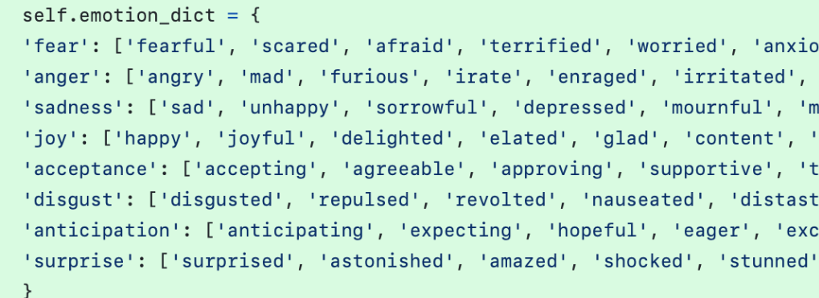
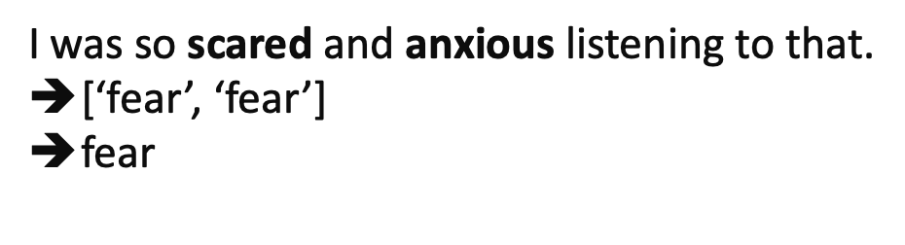
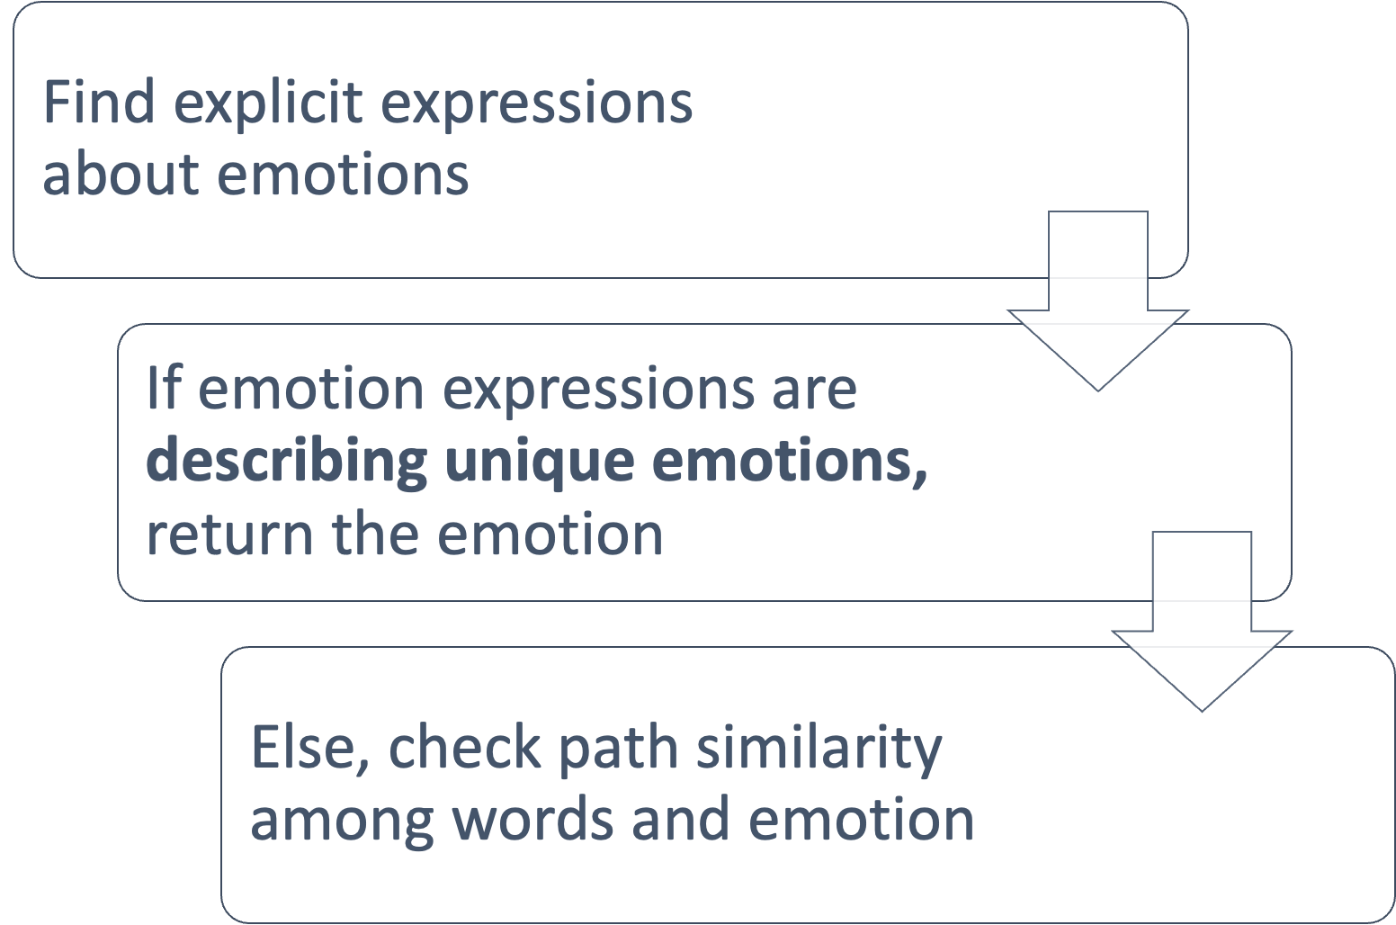

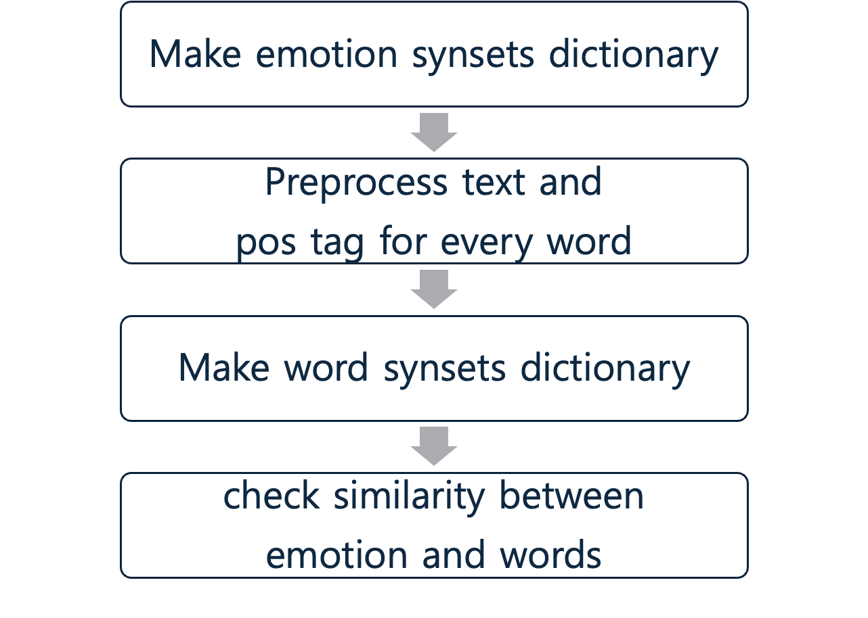
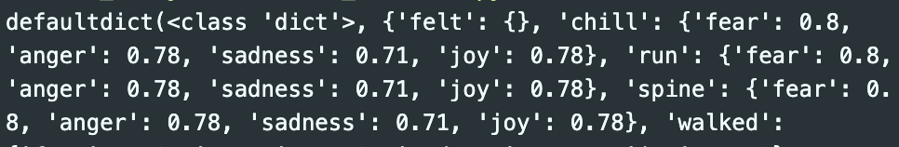
Approach - emotion detector
fear
Notes:
클릭
The Emotion Detector first checks if there are direct expressions related to emotions. If direct expressions exist and they point to a single emotion, it detects and returns that emotion. For example, in the sentence "I was so scared and anxious listening to that," both "scared" and "anxious" are related to fear, so the detector immediately returns "fear."
c클릭
But what if the expressions Point different emotions, making it ambiguous, or if there are no direct expressions? For example, in the sentence "I felt a chill run down my spine as I walked through the dark alley," we can tell that it conveys fear, but without direct expressions, it is difficult for a computer to recognize this.
클릭
To address this, we utilized the concept of WordNet learned in class. We created a synset dictionary for eight emotions, storing synsets that represent each emotion. Then, we removed stop words from the text, performed POS tagging on each word, and created a synset dictionary for each word. We calculated the similarity between the emotion-related word synsets and the sentence word synsets, storing the emotions felt from each word in a dictionary.
The Emotion Detector defines and returns the emotion based on these similarity scores, identifying the emotion that appears most frequently among the words in the sentence. If multiple emotions are felt in the sentence and it is ambiguous, it returns None.

Slide 6
Approach - matching sentiment with Character class
1st sentence: “Jack felt a chill run down his spine as he walked through the dark alley.”
Character analyzer
Character Class
Name: Jack
Emotions: {} (empty dictionary)
Final Output
Jack -> {‘fear’: [1]}
Emotion
detector
“Fear”
Detected from the text
Notes:
Finally, the characters extracted by the Character Analyzer and the emotions detected by the Emotion Detector are combined and stored in the Character class. For instance, if the sentence "Jack felt a chill run down his spine as he walked through the dark alley" is the first sentence of the novel, the Character Analyzer creates a Character class and stores the name "Jack." It also creates an empty dictionary to store the emotions Jack feels. The Emotion Detector detects the emotion "fear" from the sentence and stores it in the Emotion dictionary within the Character class for Jack, along with the index of the sentence. Ultimately, after processing all sentences, the dictionary will store in which sentences Jack felt the emotion of fear.

Slide 7
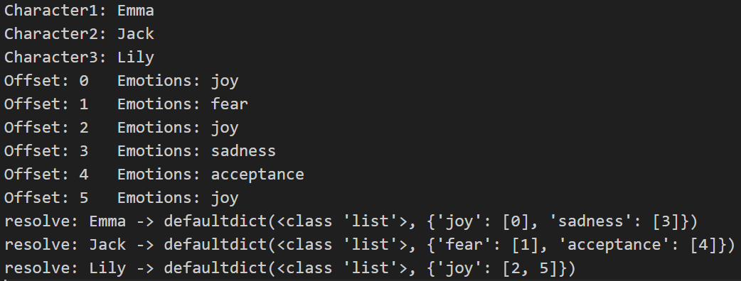
Experiment & Results
Jack
Model output
Gold Standard
Fear
[1, 2, 3]
[2, 3, 4]
?
Joy
[5]
[5, 6]
?
True Positive : 3 False Positive : 1
False Negative : 2 True Negative : 4

Slide 8
Discussion & Conclusions
We successfully implemented character sentiment analysis by implementing
character analyzer, emotion detector.
However, we still have room to improve our program.
We can improve our program to enable capturing nuanced emotional contexts and complex sentence structures.
For character analyzer, we could enhance the program by resolve coreference and distinguish subjects and objects.
For emotion detector, Using the Transformer module distributed by Hugging Face allows for highly accurate emotion extraction and resolving.
Our code is publicly available at Github, and we hope that our project could be extended further.

